Slide 1
Agentic AI Hackathon: AI Based System for Pest and Disease Risk Assessment

Slide 2


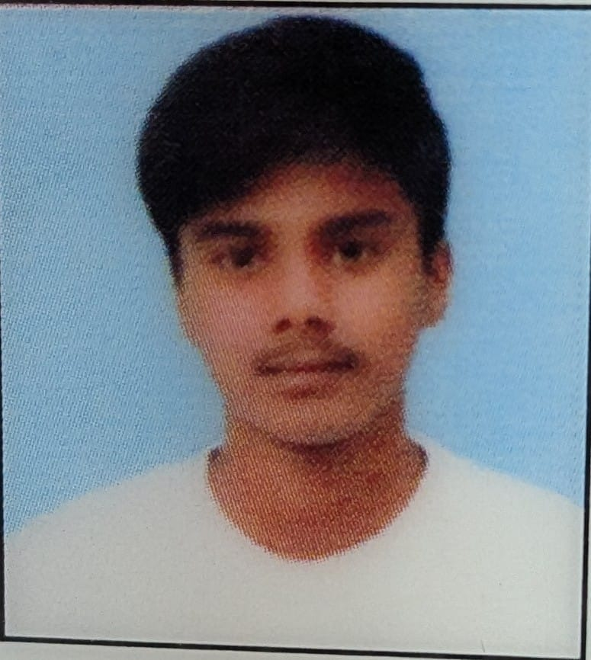
Name of the team: BUILD
Details of Team members
TEAM MEMBER NAME | Recent Passport Photo | Email ID | Phone number [WhatsApp]
Pavan D R |  | pavandr429@gmail.com | 8088317032
S G Ravidas |  | ravidassg855@gmail.com | 6366045713
Punith Gowda G |  | punithgowdag789@gmail.com | 7899688155

Slide 3
Problem statement
Farmers face severe crop losses due to late detection of pests and plant diseases.
Current challenges include:
Manual crop inspection – time-consuming and error-prone
Lack of real-time pest risk prediction
Poor access to expert agricultural advice
Climate variability increasing pest outbreaks
This results in reduced yield, higher costs, and food insecurity.

Slide 4
Proposed solution
We propose an Agentic AI-based Pest and Disease Risk Assessment System that:
Analyzes crop images uploaded by farmers
Uses weather and historical pest data
Predicts pest/disease risk levels
Provides early warnings and preventive recommendations
Powered by IBM Granite Model using Langflow Agentic AI architecture.

Slide 5
Need of project
Reduce crop loss due to pests and diseases
Enable early intervention
Support farmers with AI-driven insights
Improve agricultural productivity and sustainability
Assist agricultural officers in decision-making

Slide 6
End user of project
Farmers
Agricultural Officers
Agri-tech Companies
Government & Policy Makers

Slide 7
Technology Used
Langflow Platform
  Agent
  Chat Input
  Chat Output
  SearchApi
  URL
IBM Granite Model
  ibm-granite-3-2-8b
IBM Watsonx.ai
IBM Cloud RAG (Retrieval Augmented Generation)

Slide 8
Novelty and Uniqueness
Combines crop images + climate data + GenAI Agentic reasoning
Real-time pest and disease risk prediction
Uses Granite-guarded outputs for reliable, unbiased advice
Scalable solution for small and large farms

Slide 9
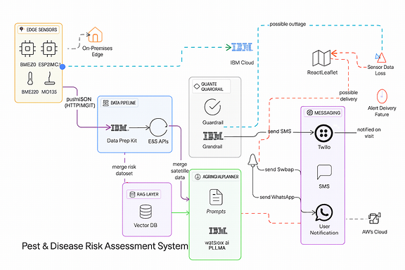
Technical flow diagram - Architecture blueprint

Slide 10
Langflow component Used
Chat Input
IBM Watsonx AI Agent
File / RAG Component
Chat Output
Langflow Components Explanation
Chat Input
Accepts crop details, symptoms, and images from farmers
2) IBM Watsonx AI Agent
Performs reasoning, prediction, and decision-making
3) File / RAG Component
Retrieves pest & disease knowledge from agricultural datasets
4) Chat Output
Displays risk assessment and recommended actions

Slide 11
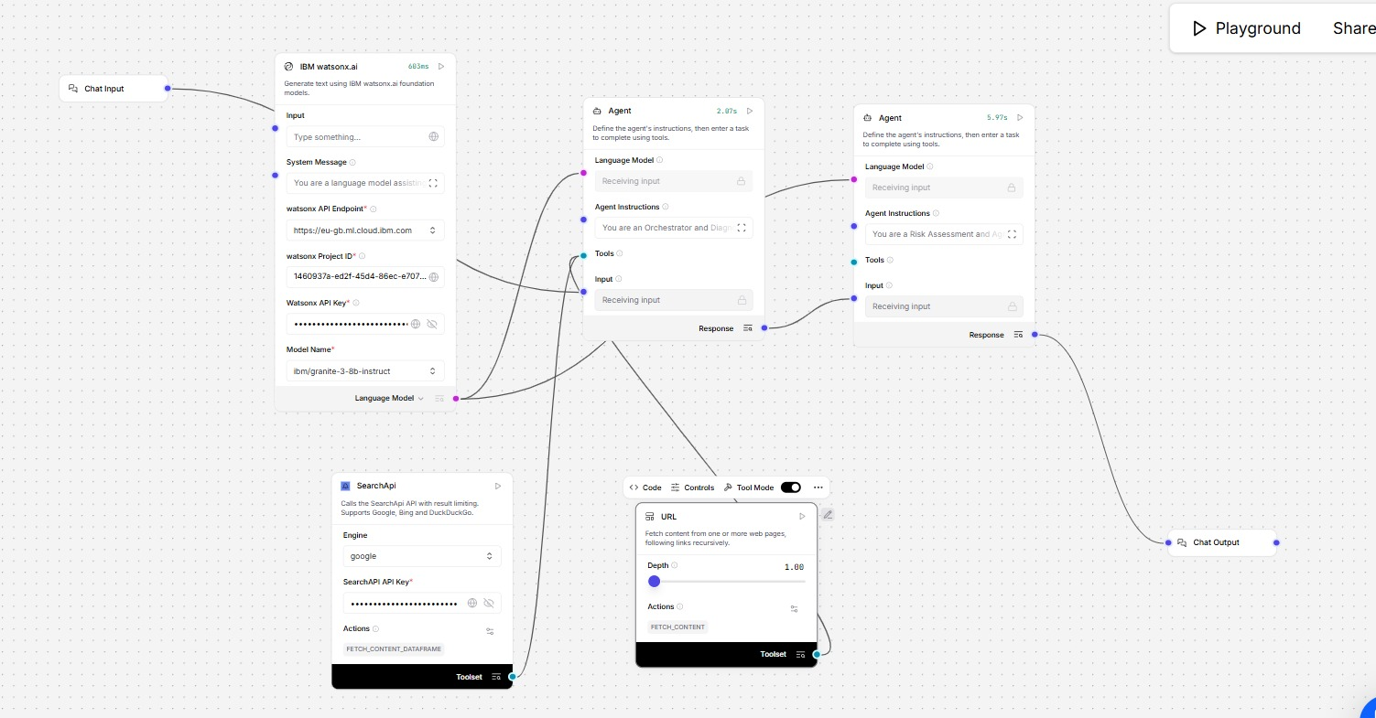
Input Screenshot 1

Slide 12
Input Screenshot 2

Slide 13
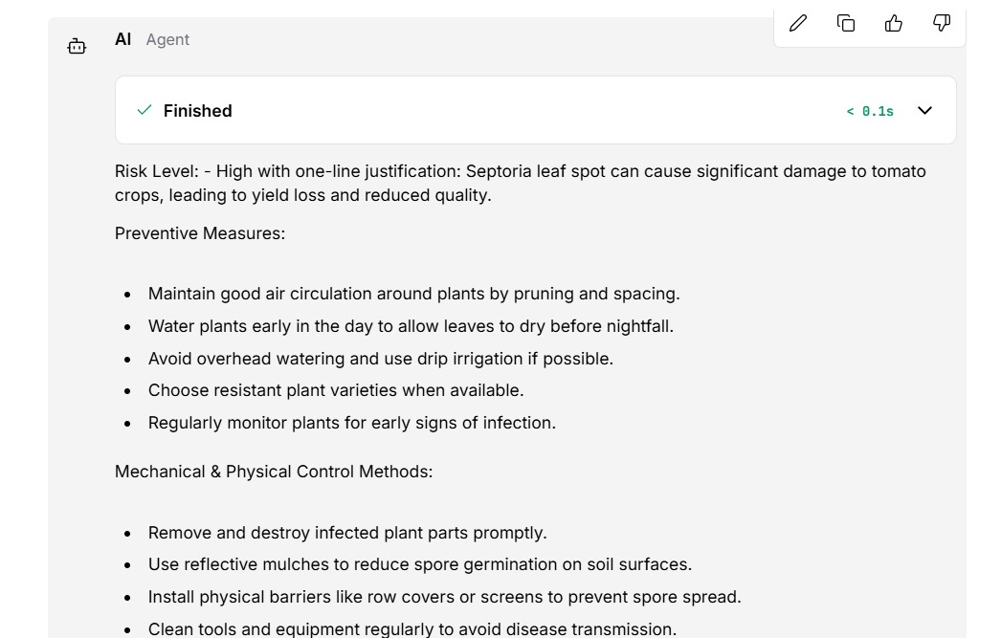
Output Screenshot 1

Slide 14
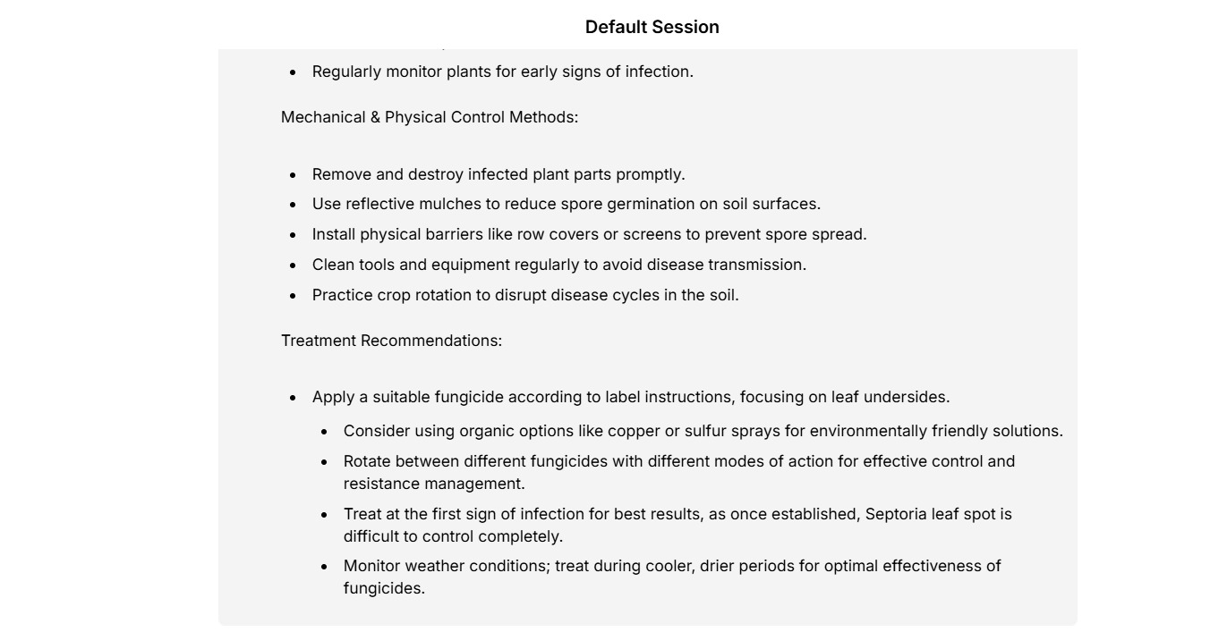
Output Screenshot 2

Slide 15
Future Scope
Integration with IoT sensors for real-time monitoring
Mobile application for farmers
Multilingual support (regional languages)
Automated pesticide & fertilizer recommendations
Government advisory integration
·
·
·

Slide 16
Git Hub Link
· Please create public github repository (Enable Add README button while creating repository) with format –
Please test and Paste the working Github URL – https://github.com/Pavan-dr-321/pest-disease-and-risk-assessment-.git
Make sure you have Uploaded following three files into your github repository
1) app.py file , 2) your_hackthon_problemstatement.pdf file 3) your projectpresntation.pptx file
·
·
·

Slide 17
References
IBM watsonx.ai Documentation
https://www.ibm.com/products/watsonx-ai
IBM Granite Foundation Models
https://www.ibm.com/granite
Langflow – Agentic AI Workflow Platform
https://www.langflow.org
FAO – Pest and Disease Risk Assessment Resources
https://www.fao.org/plant-health/en/
FAO – Integrated Pest Management (IPM)
https://www.fao.org/agriculture/crops/thematic-sitemap/theme/pests/ipm/en/
World Health Organization (WHO) – Vector & Pest Control Guidelines
https://www.who.int/teams/control-of-neglected-tropical-diseases/vector-ecology-and-management
USDA – Crop Pest and Disease Management
https://www.usda.gov/topics/crops
Research Paper: Deep Learning for Plant Disease Detection
https://ieeexplore.ieee.org/document/8457012
Climate Data for Agriculture – World Meteorological Organization (WMO)
https://public.wmo.int/en/our-mandate/climate
Retrieval Augmented Generation (RAG) – IBM Research
https://research.ibm.com/blog/retrieval-augmented-generation
·
·
·
·

Slide 18


